Slide 1
Android 4.x
Features, tips and tricks

Slide 2
Location App example

Slide 3
Create App skeleton
create and run emulator (demonstrated by trainer).
Create single activity application named “LocationApp” with package “com.training” (demonstrated by trainer).
Create a new Java class named LocationService, which extends the Service
Create Run configuration and run the app (demonstrated by trainer).

Slide 4
UI Creation

Slide 5
Add string resources
Add strings to res/values/strings.xml
<resources>
<string name="app_name">LocationApp</string>
<string name="action_settings">Settings</string>
<string name="hello_world">Hello world!</string>
<string name="lat">Latitude</string>
<string name="lon">Longitude</string>
</resources>

Slide 6
Create main layout
The simplest way. Create a parent RelativeLayout, add several TextView objects
<RelativeLayout xmlns:android="http://schemas.android.com/apk/res/android"
android:layout_width="match_parent"
android:layout_height="match_parent">
<TextView
android:layout_width="wrap_content"
android:layout_height="wrap_content"
android:text="@string/lat"
android:id="@+id/lat_title"
android:layout_alignParentLeft="true"
android:layout_marginLeft="10dp"
android:layout_alignParentTop="true"
android:layout_marginTop="10dp"/>
<TextView
android:layout_width="wrap_content"
android:layout_height="wrap_content"
android:text="0"

Slide 7
Create main layout (end)
android:id="@+id/lat_value"
android:layout_alignParentLeft="true"
android:layout_marginLeft="143dp"
android:layout_alignBottom="@+id/lat_title"/>
<TextView
android:layout_width="wrap_content"
android:layout_height="wrap_content"
android:text="@string/lon"
android:id="@+id/lon_title"
android:layout_alignLeft="@+id/lat_title"
android:layout_alignParentTop="true"
android:layout_marginTop="57dp"/>
<TextView
android:layout_width="wrap_content"
android:layout_height="wrap_content"
android:text="0"
android:id="@+id/lon_value"
android:layout_alignLeft="@+id/lat_value"
android:layout_alignBottom="@+id/lon_title"
android:singleLine="false"/>
</RelativeLayout>

Slide 8
Activity implementation

Slide 9
MainActivity class
Members initialization
public class MainActivity extends Activity {
// Logging tag and flag
private static final String TAG = MainActivity.class.getSimpleName();
private static final boolean DEBUG = true;
// TextViews to diplay latitude and longitude values
private TextView latitudeValue;
private TextView longitudeValue;
// Message code to send to Handler
private static final int MSG_NEW_LOCATION = 0;
// Broadcast receiver to get location update from service
private LocationReceiver locationReceiver;

Slide 10
MainActivity class (cont.)
onCreate method
@Override
protected void onCreate(Bundle savedInstanceState) {
super.onCreate(savedInstanceState);
setContentView(R.layout.activity_main);
// link UI elements to class members
latitudeValue = (TextView)findViewById(R.id.lat_value);
longitudeValue = (TextView)findViewById(R.id.lon_value);
// init broadcast receiver
locationReceiver = new LocationReceiver();
}

Slide 11
MainActivity class (cont.)
onStart and onStop methods
@Override
protected void onStart() {
super.onStart();
// register broadcast receiver and start the service
registerReceiver(locationReceiver, new IntentFilter(LocationService.ACTION_LOCATION_CHANGED));
Intent serviceIntent = new Intent(this, LocationService.class);
startService(serviceIntent);
}
@Override
protected void onStop() {
super.onStop();
// unregister broadcast receiver and stop the service
unregisterReceiver(locationReceiver);
Intent serviceIntent = new Intent(this, LocationService.class);
stopService(serviceIntent);
}

Slide 12
MainActivity class (cont.)
Handler implementation
// Handler to update TextViews on UI thread. It process MSG_NEW_LOCATION message
private Handler handler = new Handler() {
@Override
public void handleMessage(Message msg) {
if (DEBUG) { Log.d(TAG, "Received message " + msg.what); }
switch (msg.what) {
case MSG_NEW_LOCATION:
// get Location object from message
Location newLocation = (Location)msg.obj;
// update TextViews
latitudeValue.setText(Double.toString(newLocation.getLatitude()));
longitudeValue.setText(Double.toString(newLocation.getLongitude()));
break;
}
}
};

Slide 13
MainActivity class (end)
Broadcast receiver implementation
// Broadcast receiver to handle broadcast event from service
private class LocationReceiver extends BroadcastReceiver {
@Override
public void onReceive(Context context, Intent intent) {
if (DEBUG) { Log.d(TAG, "Received new broadcast with " + intent.getAction() + " action"); }
// get Location object from broadcast event
Location loc = intent.getParcelableExtra(LocationService.EXTRA_LOCATION);
// create message
Message message = Message.obtain();
message.what = MSG_NEW_LOCATION;
message.obj = loc;
// send it to Handler
handler.sendMessage(message);
}
}
}

Slide 14
Service implementation

Slide 15
Implement service
Create class LocationService.java in src/com.training that extends Service class
Class members definition
public class LocationService extends Service {
// Logging tag and flag
private static final String TAG = LocationService.class.getSimpleName();
private static final boolean DEBUG = true;
// Broadcast event action value
public static final String ACTION_LOCATION_CHANGED = "com.example.location.CHANGED";
// parameter in broadcast event
public static final String EXTRA_LOCATION = "app.location";
// listener to get location update
private LocationListener locationListener;

Slide 16
Implement service (cont)
onStartCommand, onDestroy and inBind
// Handle startService command for service
@Override
public int onStartCommand(Intent intent, int flags, int startId) {
if (DEBUG) { Log.d(TAG, "Service started, starting new location updater"); }
register();
return START_STICKY;
}
@Override
public void onDestroy() {
super.onDestroy();
if (DEBUG) { Log.d(TAG, "Exiting service"); }
destroy();
}
// We don't implement binding in this sample
@Override
public IBinder onBind(Intent intent) {
return null;
}

Slide 17
Implement service (cont)
Register location update listener
// Register listener to get notification about location changing
private void register() {
// get location service
LocationManager locationManager = (LocationManager) getSystemService(Context.LOCATION_SERVICE);
ocationListener = new MyLocationListener();
// invoke callback method manually first time to get current position locationListener.onLocationChanged(locationManager.getLastKnownLocation(LocationManager.GPS_PROVIDER));
String providerName = LocationManager.NETWORK_PROVIDER;
if (DEBUG) {
Log.d(TAG, "Register for location updates from provider " + providerName);
}
// register location listener to get updates on location change
locationManager.requestLocationUpdates(providerName, 1000, 0, locationListener, getMainLooper());
}

Slide 18
Implement service (cont)
Unregister location update listener
// unregister location update listener
private void destroy() {
If (DEBUG) {
Log.d(TAG, "Unregister location listener");
}
LocationManager locationManager = (LocationManager) getSystemService(Context.LOCATION_SERVICE);
locationManager.removeUpdates(locationListener);
locationListener = null;
}

Slide 19
Implement service (end)
// listener to handle onLocationChanged callback
private class MyLocationListener implements LocationListener {
@Override public void onLocationChanged(Location location) {
if (location == null) {
if (DEBUG) { Log.w(TAG, "Delivered null location object to listener"); }
return;
}
if (DEBUG) {
Log.d(TAG, "New location update: (" + location.getLatitude() + ", " + location.getLongitude() + ")");
}
// create and send broadcast with new location data
Intent locIntent = new Intent(ACTION_LOCATION_CHANGED);
locIntent.putExtra(EXTRA_LOCATION, location);
sendBroadcast(locIntent);
}
@Override public void onStatusChanged(String provider, int status, Bundle extras) {}
@Override public void onProviderEnabled(String provider) {}
@Override public void onProviderDisabled(String provider) {}
}
}

Slide 20
Run application and test it

Slide 21
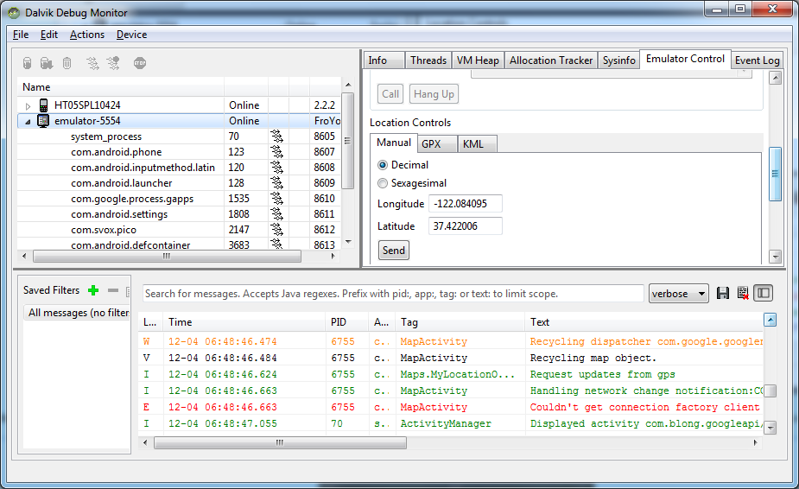
How to check it on emulator
Android DDMS console allows developer to send location events to devices

